Slide 1
Problem Solving

Slide 3
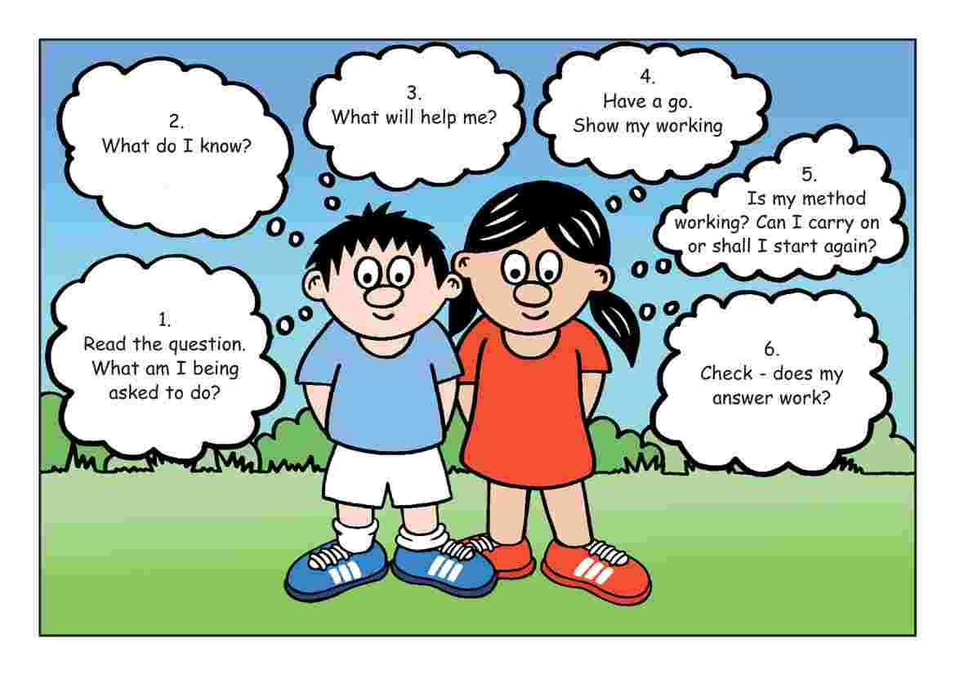

Slide 5
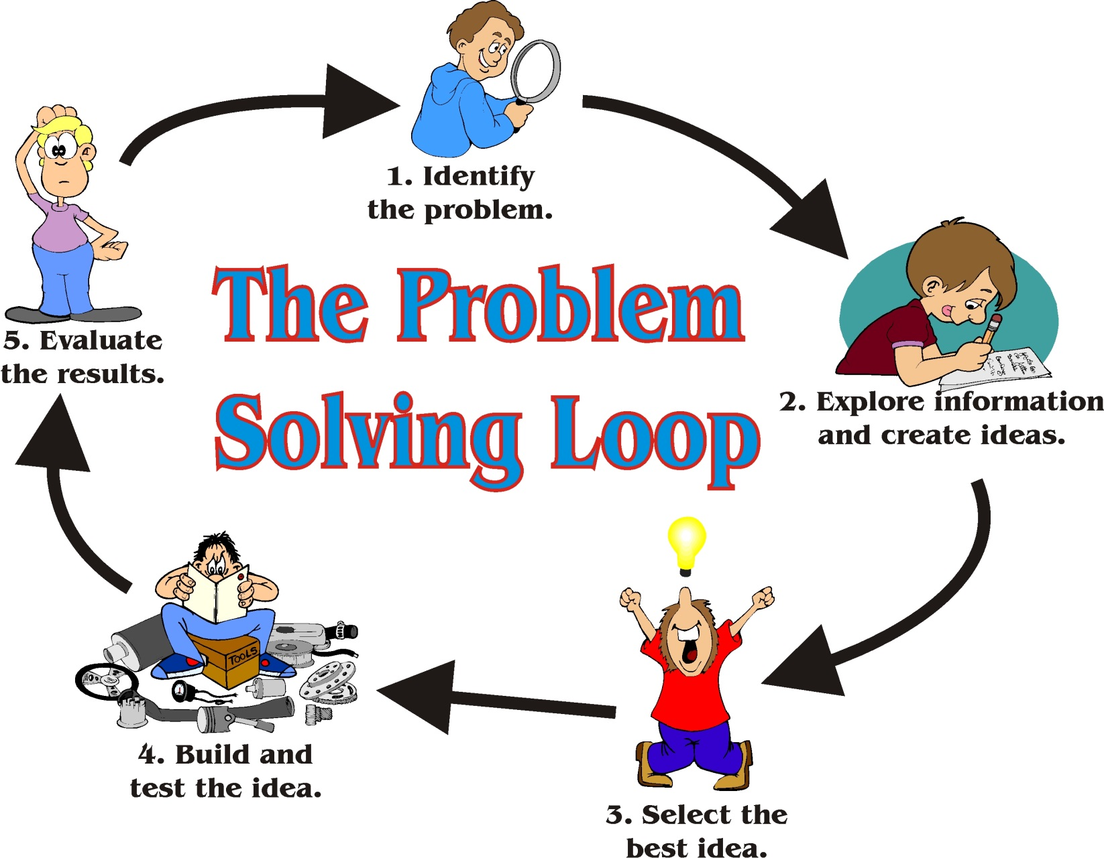
P
R
I
D
E

Slide 6
Identify the Problem

Slide 7
Do some Research

Slide 8
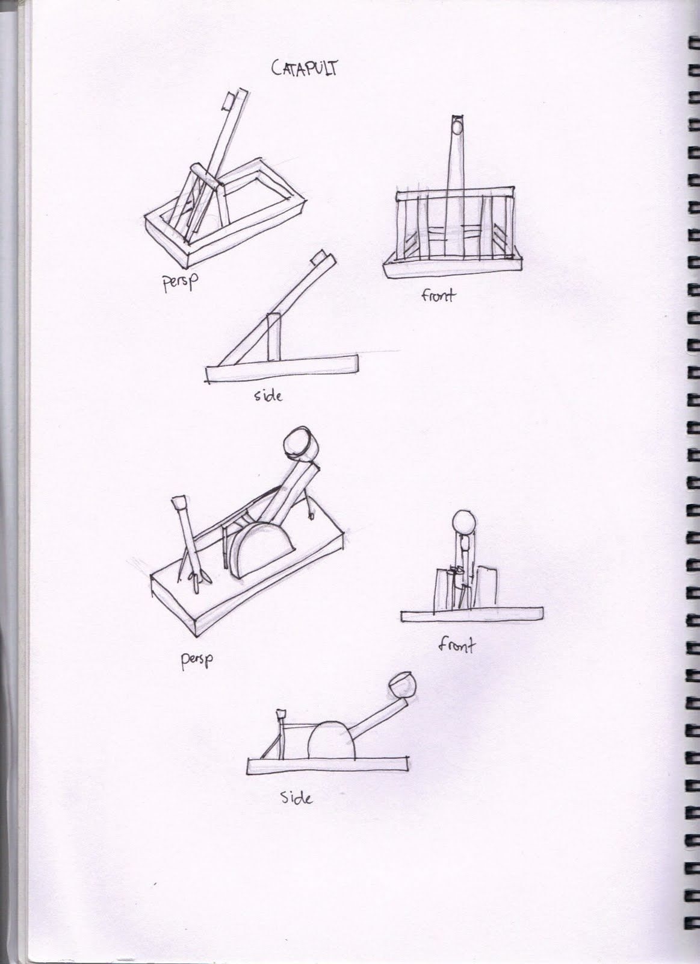
Create some ideas

Slide 9
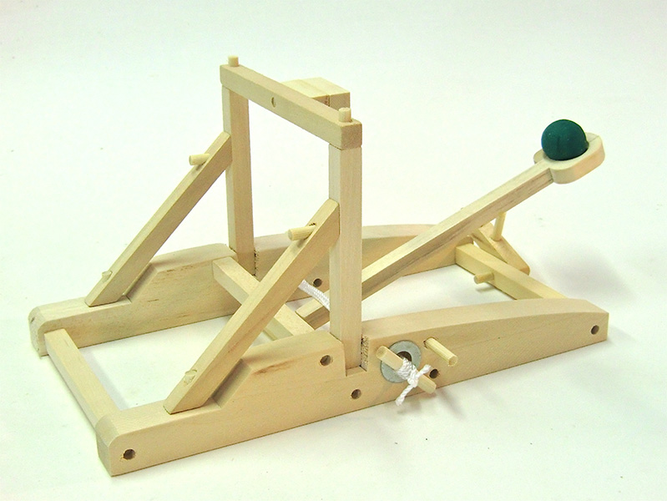
Build a Prototype

Slide 10
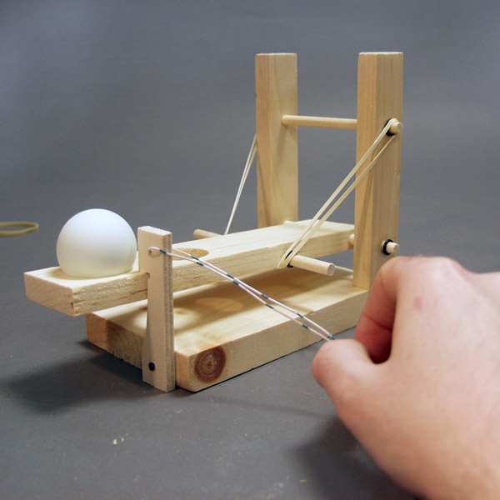
Test and Evaluate the design

